Slide 1
Walmart Retail
Weekly Sales
A prediction algorithm for weekly sales at Walmart retail locations
Capstone 2 Presentation
Damilola T. Olaiya

Slide 2
Proposal
Hypothesis → How can Walmart use its reported sales data to
predict and take advantage of future sales/demand
potentially improve inventory allocation/scheduling?
Criteria for success
Creating a model that can accurately predict the sales with regards to single and multiple features

Slide 3
Data Wrangling
The dataset contains sales information from 45 walmart stores. Source:
https://www.kaggle.com/datasets/yasserh/walmart-dataset
There were 7 features/columns:
store
weekly_sales
holiday_flag, temperature
fuel_price
cpi
unemployment.

Slide 4
Data Wrangling
The target feature is weekly_sales.
There were 6435 entries/samples in the data. This corresponded to 143 entries each for 45 stores.
There were no missing values. The data was clean.

Slide 5
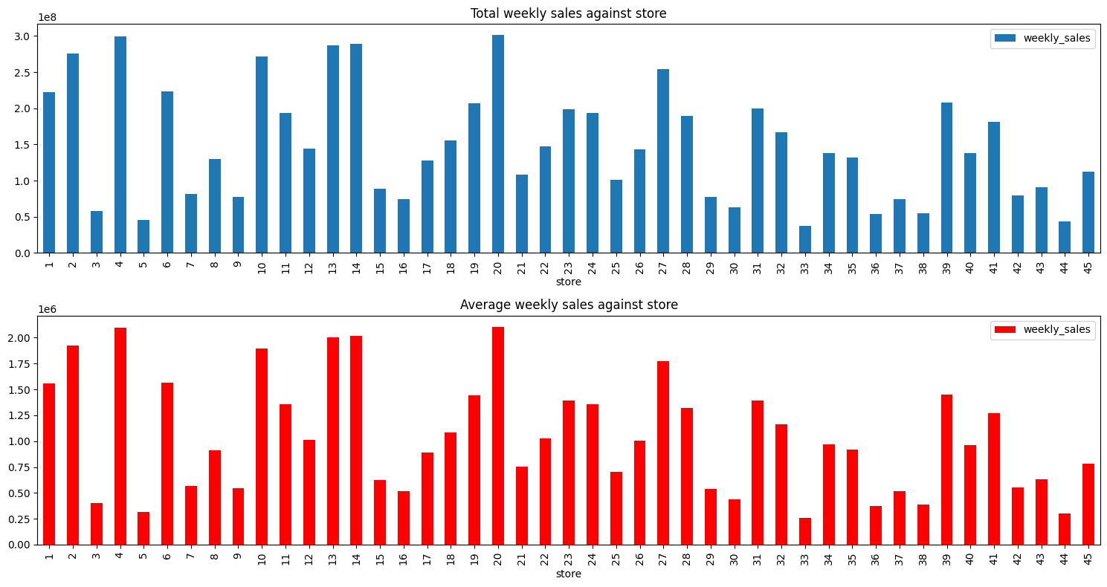
Store-to_store analysis yielded the following:
Total and Average weekly sales per store

Slide 6
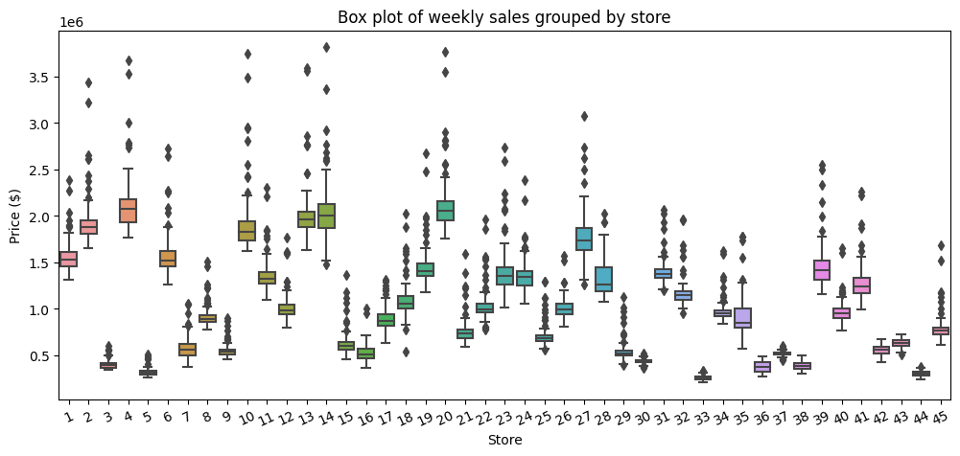
Data Wrangling
Weekly sales grouped by store

Slide 7
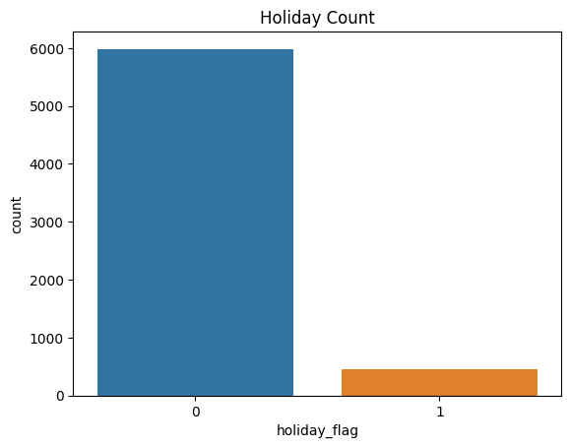
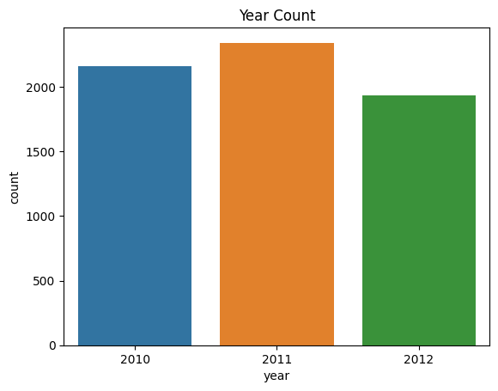
Exploratory Data Analysis (EDA)
The date feature was deconstructed. This included extracting weekday, month and year from each sample.
Categorical and numeric features were parsed and listed out. There were 2 categorical (holiday_flag, store) and 4 numerical features (unemployment, fuel_price, cpi, temperature, weekly_sales).
As expected, there are far more non-holidays than holidays.

Slide 8
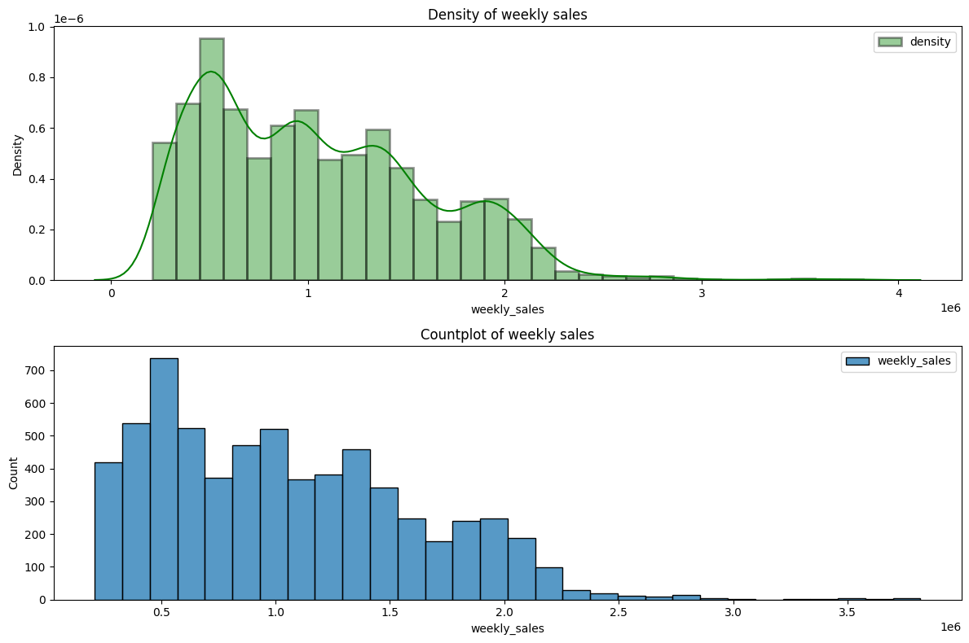
Exploratory Data Analysis (EDA)
Distribution and Countplot of weekly sales

Slide 9
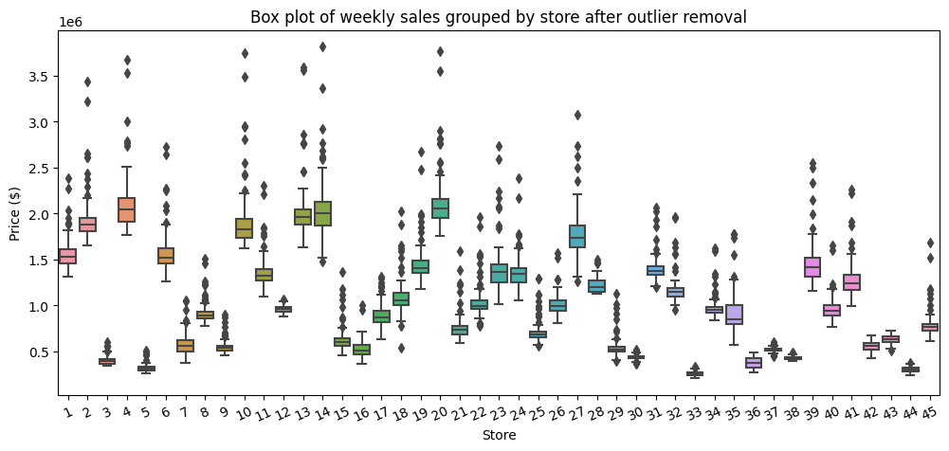
Pre-processing and Training
No duplicate rows
Outliers were removed using Inter Quartile Range (IQR).
This dropped total samples by 7.52%.

Slide 10
Pre-processing and Training
Dummy variables were created for holiday_flag, store, weekday, month and year features.
The first column was dropped in each case to prevent issues of multicollinearity.
The end result was a dataframe with 69 features/columns. This had potential to be cumbersome.
Data was split into training and test sets
Scaling/standardized to have a mean of 0 and a standard deviation of 1.
Scaling was fit using X_train only then used to transform X_test.
This was done so that the model would be completely unaffected by the testing data.

Slide 11
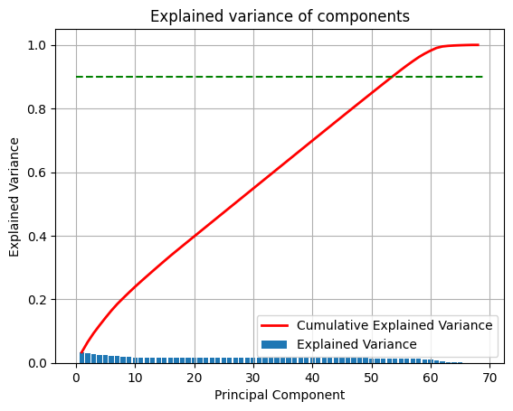
Pre-processing and Training
Principal component analysis (PCA) was performed on the data.
Using all features (no reduction), the variance was explained as such:

Slide 12
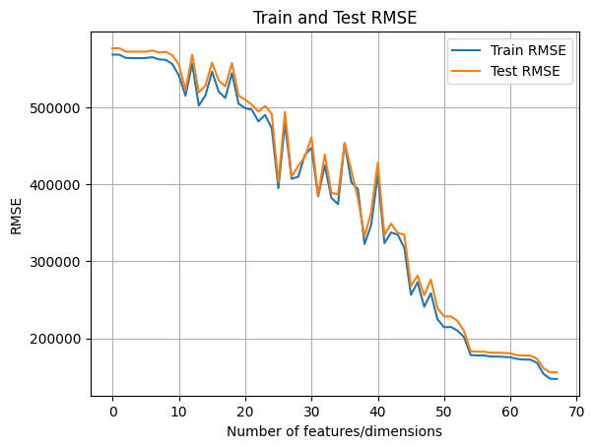
Pre-processing and Training
Using PCA and linear regression, RMSE was calculated on the train and test datasets for features ranging in number from 1 to 69. Naturally, the error reduced with more features as more variance was explained.

Slide 13
Modeling
Using dummy variables for all categorical features makes the data too granular and convoluted (69 features/columns) as evidenced by the PCA decomposition result from pre-processing.
Going forward, I assumed that all stores (store 1 to store 45) are within the same market segment and ignored store to store differences.
Additionally, the holiday_flag feature did not need to be standardized as the values were already within scale for analysis.
To that effect, I mapped the holiday_flag feature back to 1s and 0s and eliminated the store, month and year features from the data.
This left 11 features remaining in the dataset (holiday_flag, temperature, fuel_price, cpi, unemployment, weekday_1, weekday_2, weekday_3, weekday_4, weekday_5, weekday_6).

Slide 14
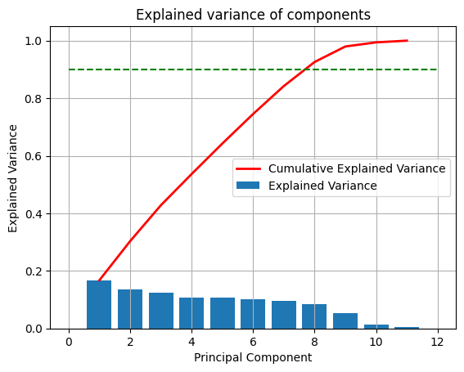
Modeling
I was able to infer that feature reduction may be unnecessary as, although 90% of the variance is explained cumulatively by 8/11 principal components, only one of the components had a variance that was significantly lower than the others.
That, combined with the relatively small number of features, allowed me to ignore feature reduction.

Slide 15
Modeling
There were four different models used
multiple linear regression
lasso regression
ridge regression
random forest regression.
Cross validation was performed for ridge, lasso and random forest regressions using:
alphas of 0.1, 1, 10, 100,1000 and 10000 for lasso and ridge regression
parameters {n_estimators: [300,400,500], max_depth:[4,6,8], min_samples_leaf :[0.1,0.2], max_features:['log2','sqrt']} for random forest regression

Slide 16
Modeling
The best alpha for both lasso and ridge was found to be 100.
The best parameters for the random forest regression were found to be:
max_depth: 6
max_features: log2
min_samples_leaf: 0.1
n_estimators: 400

Slide 17
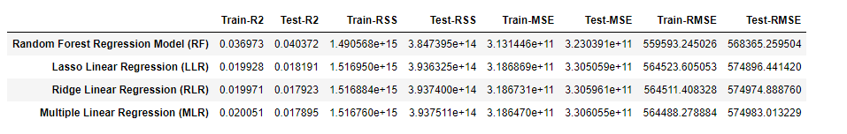
Model Evaluation Comparison Matrix (MECM)
The following metric were used to evaluate both training and test datasets
R^2 or Coefficient of determination
Sum of squared residuals
Mean squared error
Root mean squared error

Slide 18
Inference
Lower RMSE implies a better the model. That said, a significant disparity between training and testing scores would suggest overfitting.
All regression models were fairly similar in terms of training and test R2 and RMSE.
However, Multiple linear regression performed best in training metrics but worst in test metrics suggesting that it was slightly overfitting.

Slide 19
Inference
This is in line with what we would expect from lasso and ridge regression which work to combat overfitting.
Random forest regression performed best for all metrics and gave the best overall results.

Slide 20
Conclusions
The dataset was quite small with just 6435 samples initially, which dropped 7.5% after cleaning.
Cross validating the Lasso and Ridge regressions allowed us to select the best alpha.
We will proceed with the Random forest regression model as it performed best.

Slide 21
Further Steps to Consider
Using pca for feature reduction
Using more of the generated features in the regression
Testing more parameters in the grid search cv at the cost of time
Using random forest with bagging, boosting etc
Using a polynomial regression model

